Slide 1
Predicting credit default risk to reduce financial losses
By Abigael Kariuki
February 2026

Slide 2

Outline
Business Problem
Stakeholders
Dataset
Exploratory Data Analysis (EDA)
Modelling
Limitations
Business Recommendations
Conclusions

Slide 3

Business problem
Banks and financial institutions face significant losses when customers default on credit payments.
The goal of this project is to predict the likelihood of default next month, allowing lenders to:
Reduce losses
Improve risk-based pricing
Intervene early with high-risk customers
We will build and evaluate models to predict default, using borrower demographics and credit behavior, with a focus on identifying defaulters.

Slide 4

Stakeholders
Primary stakeholders:
Credit risk and risk analytics teams in banks and financial institutions
Secondary stakeholders:
Product managers responsible for pricing and credit limits
Collections teams prioritising outreach of potential customers
Senior management monitoring portfolio risk

Slide 5

Dataset
The dataset used is the UCI Credit Card Default dataset, which contains 30,000 observations of credit card clients.
It includes:
Demographic information eg age, gender, education, etc
Credit limits
Historical outstanding debt amounts
Repayment behavior over six months
Whether the customer defaulted in the previous months and others

Slide 6
Variables
Target Variable
Default status
1 = Default
0 = No default
This is a binary classification problem.
Features (independent variables)
There are 25 total feature variables in our dataset.
All of them were used as predictors, excluding the unique identifier (`ID`). A few include:
-Credit limit (LIMIT_BAL)
-Demographic variables (AGE, EDUCATION, SEX, MARRIAGE)
-Repayment status history (PAY_0 to PAY_6)
-Monthly bill statement amounts (BILL_AMT1 to BILL_AMT6)
-Monthly payment amounts (PAY_AMT1 to PAY_AMT6)

Slide 7
Exploratory Data Analysis (EDA)

Slide 8
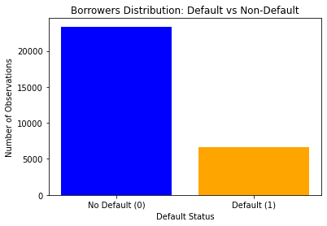
Distribution of borrowers: majority are non-defaulters, resulting in an imbalanced dataset
The dataset has 30,000 borrowers. The distribution of borrowers is as follows:
Non-defaulters: 23,364 (78%)
Defaulters: 6,636 (22%)
This shows the dataset is highly imbalanced, with non-defaulters making up the majority.
This creates a challenge for the model, as it may favor predicting non-defaulters.
To address this, class weights are applied in the modelling to prioritize detecting defaulters and reduce false negatives (i.e., borrowers who default but are predicted as non defaulters).

Slide 9
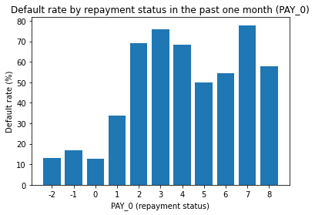
Credit default rate by repayment status: it increases significantly as repayment delays become more severe
Borrowers with recent loan payments (status 0) have default rates below 10%.
Borrowers with recent payment delays (e.g., status 6 and above) show sharply higher default probabilities.
Severe delays (status 6 and above) show default rates above 50–70%.
Therefore, recent payment delays (delinquency) are a strong indicator of future loan defaults

Slide 10
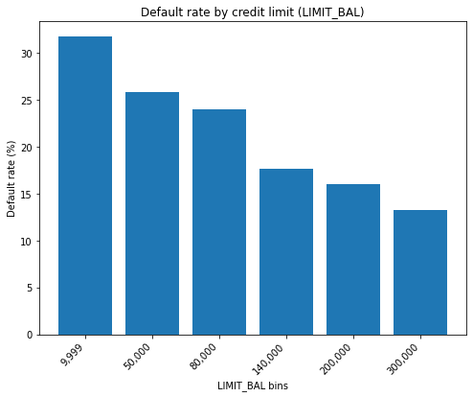
Credit default rate by credit limit: higher limits are associated with lower default risk
Borrowers with higher credit limits tend to have lower default rates
Those with lower credit limits tend to default more frequently, signaling that borrowers with lower financial capacity are more likely to default.
Credit capacity is a key indicator of financial stability, with higher credit limits correlating to a lower likelihood of default.

Slide 11
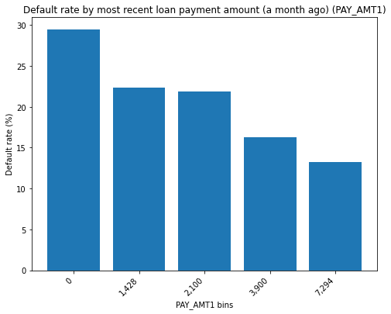
Credit default rate by recent loan payment amount: default risk decreases as payment amounts increase
Borrowers making smaller recent payments show higher default rates.
As recent payment amounts increase, default risk steadily declines.
Customers making larger payments demonstrate stronger repayment capacity.
Repayment capacity is therefore an important indicator of credit stability.

Slide 12
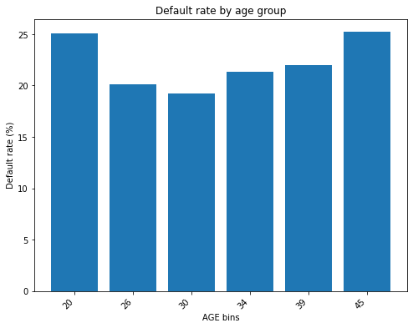
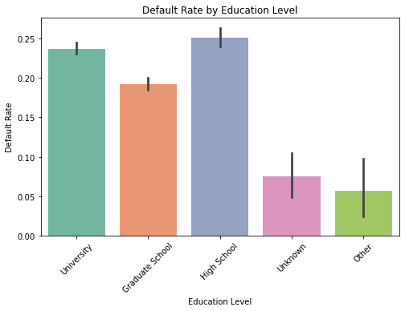
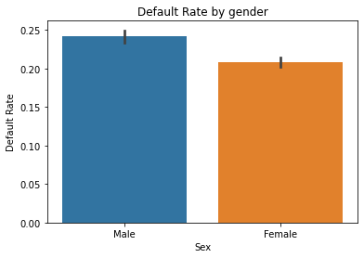
Credit default rate by borrower characteristics: demographic factors show limited variation in default risk
Default rates vary slightly across age, gender, education, and marital status.
Differences between demographic groups are not substantial.
No strong pattern suggests that demographics alone drive default risk.
Behavioral factors (repayment history and payment behavior) remain more influential predictors of default.

Slide 13
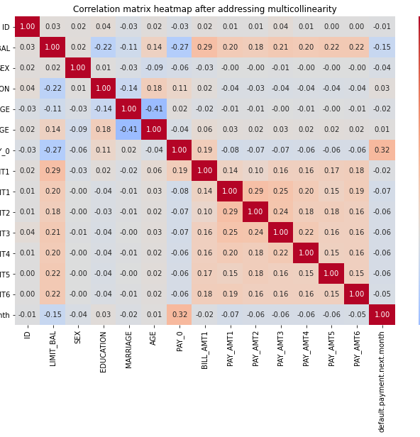
Addressing multicollinearity
A multicollinearity check revealed strong correlations between several variables, particularly those linked to their past values.
Highly correlated variables included:
Repayment status: PAY_2–PAY_6
Bill amounts: BILL_AMT2–BILL_AMT6
To reduce multicollinearity, we retained:
PAY_0 (most recent repayment status)
BILL_AMT1 (most recent bill amount)
After removing redundant variables, 14 features were used in the modeling process.
This reduction in collinearity enhances model stability and interpretability

Slide 14
Modelling
Objective: Predict the probability of a borrower defaulting.
We focused on four models:
Logistic regression
Logistic regression with class weights (balanced)
Decision tree
Decision tree with class weights (balanced)

Slide 15
Model 1: Logistic Regression (baseline, without class weights)
The model was trained to predict borrower defaults. Evaluation metrics: accuracy, precision, recall, and F1-score
Focus was on maximizing recall to minimize false negatives (defaulters misclassified as non-defaulters)
The model achieved 81.2%, but it missed 75% of the actual defaulters (low recall of 25%).
Precision for defaulters was 71%, meaning when predicted, the model is correct 71% of the time.
False negatives are significant, with 991 defaulters incorrectly classified as non-defaulters.
Given the low recall, we added class weights to the model to help better detect and prioritize defaulter
Classification report
Accuracy = 81.2%
 | Precision | Recall | F1-score
Non-defaulters(0) | 0.82 | 0.97 | 0.89
Defaulters (1) | 0.71 | 0.25 | 0.37
Confusion matrix
4,538 (TN) | 135 (FP)
991 (FN) | 336 (TP)

Slide 16
Model 2: Logistic Regression (with class weights)
The model was trained with class weights to handle class imbalance, focusing on improving recall for defaulters, which increased from 25% to 62%.
It correctly identified 824 out of 1,327 defaulters, cutting false negatives nearly by half (from 991 to 503)
Accuracy decreased from 81% in the baseline model to 75%; expected when prioritizing the minority class.
Reducing missed defaulters is more important than maximizing overall accuracy.
This model outperformed the baseline model.
We then did decision tree model to capture non-linear relationships, complex feature interactions and further improve recall for defaulters.
Classification report
Accuracy = 75%
 | Precision | Recall | F1-score
Non-defaulters (0) | 0.86 | 0.69 | 0.77
Defaulters (1) | 0.36 | 0.62 | 0.46
Confusion matrix
3,219 (TN) | 1, 454 (FP)
503 (FN) | 824 (TP)

Slide 17
Model 3: Decision tree model (without class weights)
Classification report
Accuracy = 72.4%
The model achieved an accuracy of 72%, with a recall of 41% for defaulters.
Recall for defaulters improved from 25% in the baseline logistic regression to 41%, compared to 62% in the balanced logistic regression model, reducing missed defaulters from 991 to 784
This model performed worse than the balanced logistic regression in handling class imbalance.
Therefore, we proceeded to retrain the model with class weights to better handle imbalance and improve recall.
 | Precision | Recall | F1-score
Non-defaulters(0) | 0.83 | 0.81 | 0.82
Defaulters (1) | 0.38 | 0.41 | 0.40
Confusion matrix
3,802 (TN) | 871(FP)
784 (FN) | 543 (TP)

Slide 18
Model 4: Decision tree model (with class weights)
Classification report
Accuracy = 73.8%
The Decision Tree model (with class weights) achieved 74% accuracy, with a recall of 44%, identifying 579 out of 1,327 defaulters and missing 748 high-risk borrowers.
Compared to the logistic regression(with class weights whose recall was at 62%, the balanced Decision Tree performs worse at detecting defaulters.
Although it captures nonlinear relationships, increasing model complexity did not improve minority class detection.
 | Precision | Recall | F1-score
Non-defaulters(0) | 0.84 | 0.82 | 0.83
Defaulters (1) | 0.41 | 0.44 | 0.42
Confusion matrix
3,854(TN) | 819(FP)
748 (FN) | 579 (TP)

Slide 19
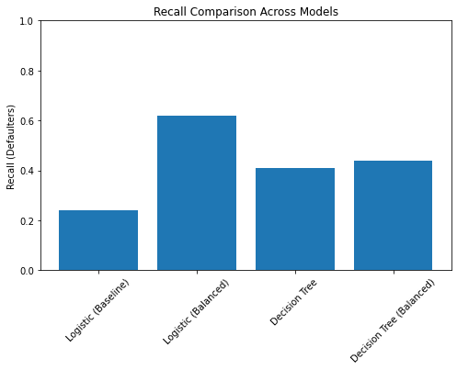
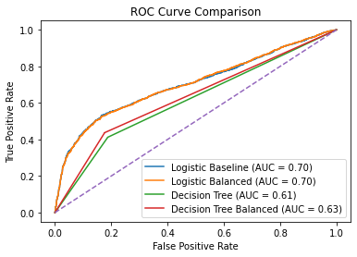
Final model selection
Evaluation approaches:
Recall: Prioritized for detecting defaulters. Logistic regression (with class weights) achieved the highest recall at 62%.
ROC AUC curve: Measures the model’s ability to separate defaulters. Logistic regression (with class weights) had the highest AUC at 0.71.
The logistic regression (with class weights) model significantly improved defaulter detection, outperforming the others.
Given the business goal to minimize missed high-risk borrowers, it was selected.
Its performance metrics are a recall of 62% for defaulters, a precision of 37%, an accuracy of 68%, and an AUC of 0.71

Slide 20
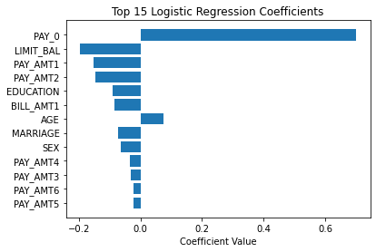
Features importance of Logistic regression (with class weights)
Following model selection, we analyzed feature importance to identify key predictors of default risk.
The most influential factor is recent repayment status (PAY_0), where higher values indicate more severe delays and increased default risk.
Conversely, higher recent payment amounts (PAY_AMT1, PAY_AMT2) and credit limits (LIMIT_BAL) are linked to lower default risk, suggesting that better repayment behavior and higher credit capacity reduce the likelihood of default.

Slide 21
Conclusions
Recent repayment behavior is the strongest driver of default risk.
Higher credit limit reduces default risk (negative coefficient).
Recent payment delays are a strong indicator of future default, highlighting the need for early intervention strategies for at-risk customers.
Credit limit adjustments should be dynamic, rewarding good repayment behavior and minimizing exposure to high-risk borrowers.

Slide 22
Recommendations
Closely monitor customers with recent missed or delayed payments, as they exhibit significantly higher default risk.
Implement early intervention strategies such as reminder notifications or repayment support for at-risk customers.
Carefully review credit limits, recognizing that customers with stronger credit profiles and higher limits tend to have lower default risk.
Use dynamic credit limit adjustments as part of ongoing risk management, rewarding consistent repayment behavior while reducing exposure to higher-risk borrowers.
Deploy the model as a risk-screening tool to flag high-risk accounts for further review rather than relying solely on automatic rejection.
By proactively identifying borrowers who show early warning signs, the banks can reduce credit losses and improve overall portfolio risk management.

Slide 23

Stakeholders
Primary stakeholders:
Credit risk and risk analytics teams in banks and financial institutions
Secondary stakeholders:
Product managers responsible for pricing and credit limits
Collections teams prioritising outreach of potential customers
Senior management monitoring portfolio risk

Slide 24
Model 1: Logistic Regression (baseline, without class weights)
The model was trained to predict borrower defaults. Evaluation metrics: accuracy, precision, recall, and F1-score
Focus was on maximizing recall to minimize false negatives (defaulters misclassified as non-defaulters)
The model achieved 81.2%, but it missed 75% of the actual defaulters (low recall of 25%).
Precision for defaulters was 71%, meaning when predicted, the model is correct 71% of the time.
False negatives are significant, with 991 defaulters incorrectly classified as non-defaulters.
Given the low recall, we added class weights to the model to help better detect and prioritize defaulter
Classification report
Accuracy = 81.2%
 | Precision | Recall | F1-score
Non-defaulters(0) | 0.82 | 0.97 | 0.89
Defaulters (1) | 0.71 | 0.25 | 0.37
Confusion matrix
4,538 (TN) | 135 (FP)
991 (FN) | 336 (TP)

Slide 25
Model 2: Logistic Regression (with class weights)
The model was trained with class weights to handle class imbalance, focusing on improving recall for defaulters, which increased from 25% to 62%.
It correctly identified 824 out of 1,327 defaulters, cutting false negatives nearly by half (from 991 to 503)
Accuracy decreased from 81% in the baseline model to 75%; expected when prioritizing the minority class.
Reducing missed defaulters is more important than maximizing overall accuracy.
This model outperformed the baseline model.
We then did decision tree model to capture non-linear relationships, complex feature interactions and further improve recall for defaulters.
Classification report
Accuracy = 75%
 | Precision | Recall | F1-score
Non-defaulters (0) | 0.86 | 0.69 | 0.77
Defaulters (1) | 0.36 | 0.62 | 0.46
Confusion matrix
3,219 (TN) | 1, 454 (FP)
503 (FN) | 824 (TP)

Slide 26
Model 3: Decision tree model (without class weights)
Classification report
Accuracy = 72.4%
The model achieved an accuracy of 72%, with a recall of 41% for defaulters.
Recall for defaulters improved from 25% in the baseline logistic regression to 41%, compared to 62% in the balanced logistic regression model, reducing missed defaulters from 991 to 784
This model performed worse than the balanced logistic regression in handling class imbalance.
Therefore, we proceeded to retrain the model with class weights to better handle imbalance and improve recall.
 | Precision | Recall | F1-score
Non-defaulters(0) | 0.83 | 0.81 | 0.82
Defaulters (1) | 0.38 | 0.41 | 0.40
Confusion matrix
3,802 (TN) | 871(FP)
784 (FN) | 543 (TP)

Slide 27
Model 4: Decision tree model (with class weights)
Classification report
Accuracy = 73.8%
The Decision Tree model (with class weights) achieved 74% accuracy, with a recall of 44%, identifying 579 out of 1,327 defaulters and missing 748 high-risk borrowers.
Compared to the logistic regression(with class weights whose recall was at 62%, the balanced Decision Tree performs worse at detecting defaulters.
Although it captures nonlinear relationships, increasing model complexity did not improve minority class detection.
 | Precision | Recall | F1-score
Non-defaulters(0) | 0.84 | 0.82 | 0.83
Defaulters (1) | 0.41 | 0.44 | 0.42
Confusion matrix
3,854(TN) | 819(FP)
748 (FN) | 579 (TP)

Slide 28
Final model selection
Evaluation Approaches:
Recall: Prioritized for detecting defaulters. Logistic regression (with class weights) achieved the highest recall at 62%.
ROC–AUC: Measures the model’s ability to separate defaulters. Balanced logistic regression had the highest AUC at 0.71.
The balanced logistic regression model significantly improved defaulter detection, outperforming the others. Given the business goal to minimize missed high-risk borrowers, it was selected.
Its performance metrics are a recall of 62% for defaulters, a precision of 37%, an accuracy of 68%, and an AUC of 0.71

